Slide 1
Logistic Regression

Slide 2
Logistic Regression - Topics
Introduction to Logistic Regression
Logit function in Logistic Regression
Probability Examples
Confusion Matrix
F1 Score, gini index and ROC curve
Pros and Cons of Logistic Regression
Case study on Logistic Regression

Slide 3
Introduction to Logistic Regression
In statistics, the logistic model is a statistical model that is usually taken to apply to a binary dependent variable.
In regression analysis, logistic regression or logit regression is estimating the parameters of a logistic model.
In Logistic Regression, the dependent variable is binary rather than continuous and it can also be applied to ordered categories (ordinal data).

Slide 4
The term “Odds”
Popular in horse races, sports, gambling, epidemiology,
Instead of talking about the probability of winning or contacting a disease, people talk about the odds of winning or contacting a disease
How are these two different?
Additional content: Not part of the video but will be useful for getting an industry perspective

Slide 5


Logit function in Logistic Regression
In logistic regression, the dependent variable is a logit, which is the natural log of the odds, that is,
Additional content: Not part of the video but will be useful for getting an industry perspective

Slide 6
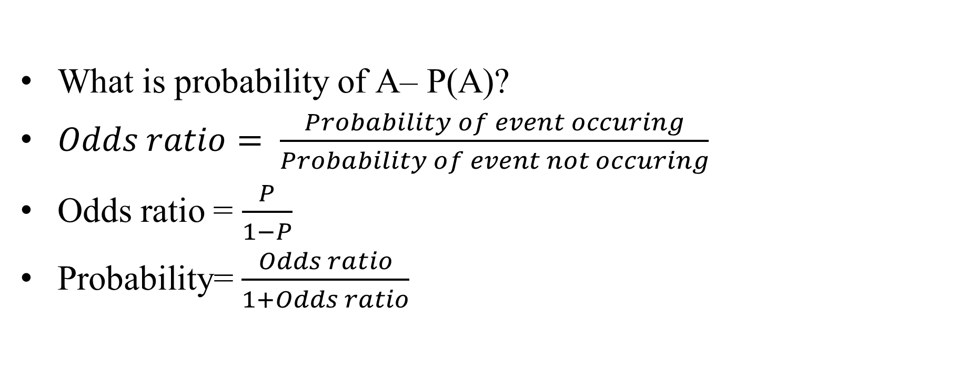
Odds vs Probability
Additional content: Not part of the video but will be useful for getting an industry perspective

Slide 7
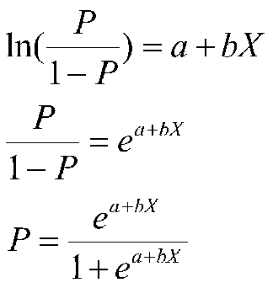
Math behind Logistic Regression
So a logit is a log of odds and odds are a function of P, the probability of a 1. In logistic regression, we find
logit(P) = a + bX,

Slide 8
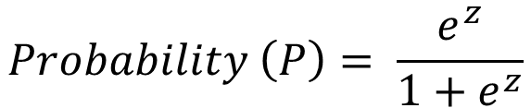

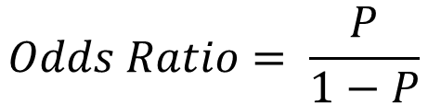
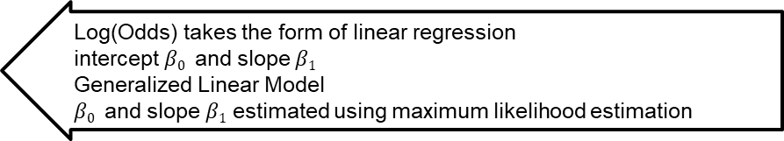
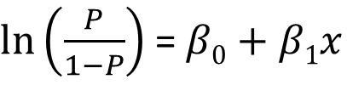
Math behind Logistic Regression
Predict likelihood or probability
Predicted value - >0 and <1
Use of sigmoid function to achieve this

Slide 9
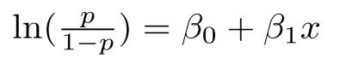
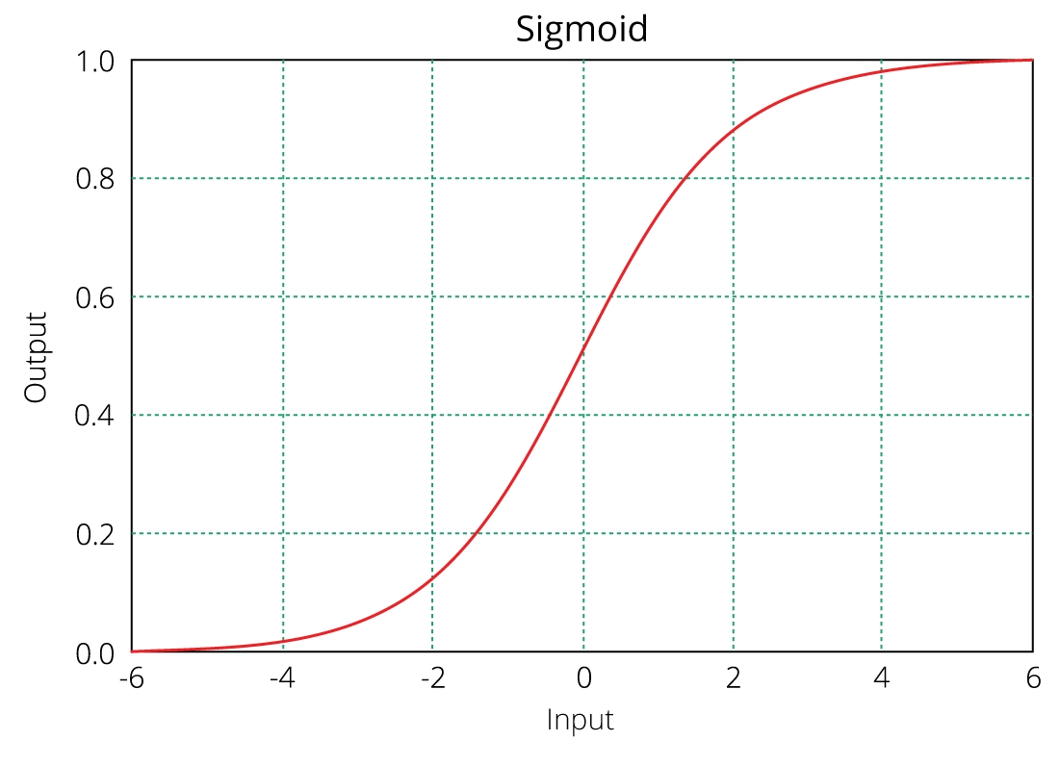
Equation of logistic regression
log - odds or odds ratio or logit function and is the link function for Logistic Regression
Regression intercept & coefficient
This link function follows a sigmoid function which limits its range of probabilities between 0 and 1.

Slide 10
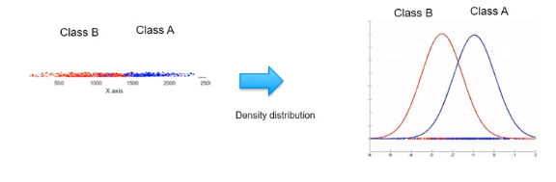
Probability Examples
Given the value of predictor (variable x), the model estimates the probability that the new data point belongs to a given class “A”. Probability values can range between 0 and 1.

Slide 11
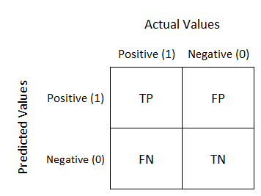
Confusion Matrix
Well, it is a performance measurement for machine learning classification problem where output can be two or more classes. It is a table with 4 different combinations of predicted and actual values.

Slide 12
Confusion matrix
 |  | Predicted
 |  | 0 | 1
Observed | 0 | TN | FP
 | 1 | FN | TP
Employees who will actually not attrite but predicted as will attrite
Employees who will actually attrite but predicted as will not attrite

Slide 13
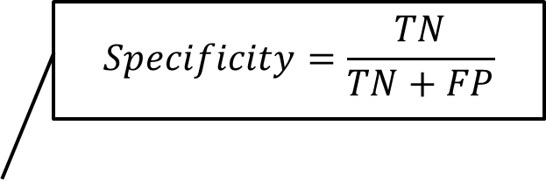
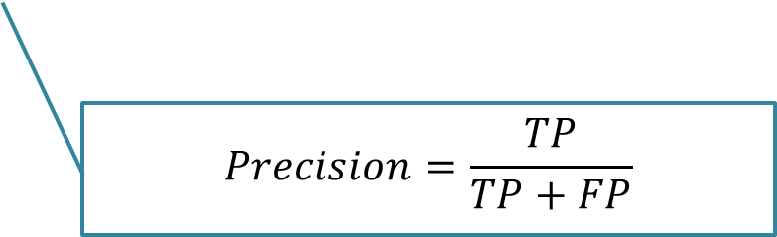
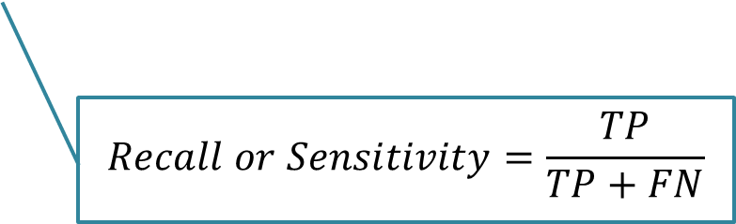
Confusion Matrix
 |  | Predicted
 |  | 0 | 1
Observed | 0 | TN | FP
 | 1 | FN | TP

Slide 14
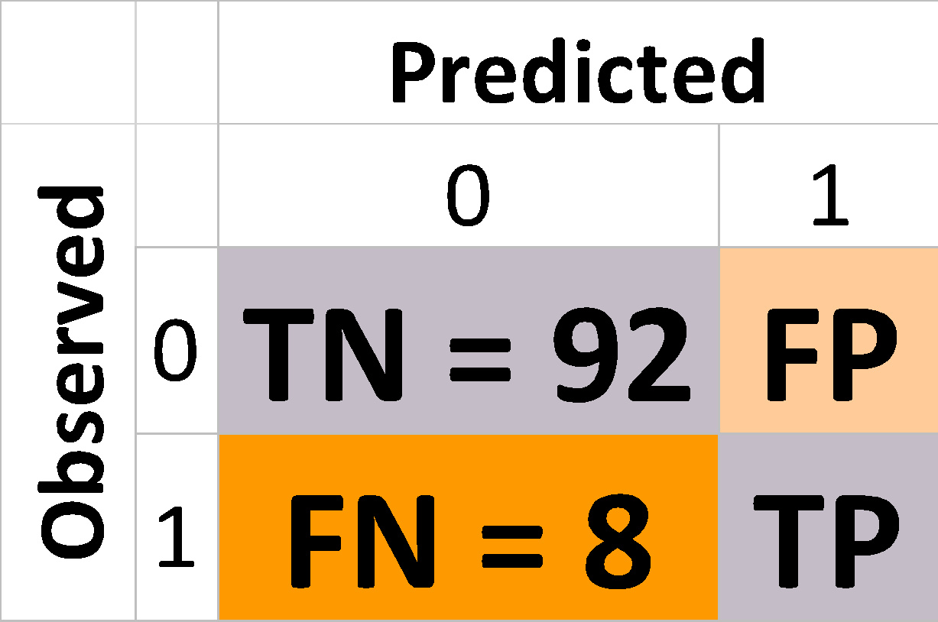
Why accuracy is not a good model performance measure?
# Total customers – 100 # of customers who churn - 8
Churn rate – 8%
Model predicts that no one churns
Accuracy – 92%
Misses out critical customers who churn

Slide 15
F1 Score
A single metric is not sufficient for the evaluation of classification models. We have seen that we need to use recall and precision together along with accuracy to evaluate our model.
Let us consider another metric that puts together the recall and precision metrics. We call it F1 Score.
F1 Score = 2(precision*recall)/precision + recall
-which is the harmonic mean of the two metrics.
The F1 score can also be used to evaluate the model.

Slide 16
ROC and Gini Coefficient and Threshold
Roc is a curve which allows us to compare models.
It is plot between TPR(true positive rates) and FPR(false positive ratio).
The area under the ROC curve (AUC) is a measure of the how good a model is.
Gini Coefficient:
It is also used to measure the goodness of a fit.
It is the ratio of areas in a roc curve and is scaled version of the AUC.
GI = 2*AUC -1

Slide 17
Pros and Cons of logistic regression
Pros:
It is a model that gives probabilities.
It can be easily scaled to multiple classes.
It is very quick to train and very fast at classifying unknown records.
Cons:
The classifies constructs liner boundaries.
Assumes that the variables are independent.
Interpretation of coefficients is difficult.

Slide 18
Hands on exercise on Logistic Regression

Slide 19


AIML @WORK
PGPAIML @ Great Learning
Enabling Learners to Apply the AI/ML Concepts at Work
Apply AIML at your workplace to gain some instant benefits:
Get noticed by your management with your outstanding analysis backed by data science.
Create an impact in your organization by taking up small projects/initiatives to solve critical issues using data science.
Network with members from the data science vertical of your organization and seek opportunities to contribute in small projects.
Share your success stories with us and the world to position yourself as a subject matter expert in data science.
AIML Operations | AIMLAW
@Great Learning Proprietary Content. All rights reserved. Unauthorized use or distribution prohibited

Slide 20


Questions?

